Slide 1
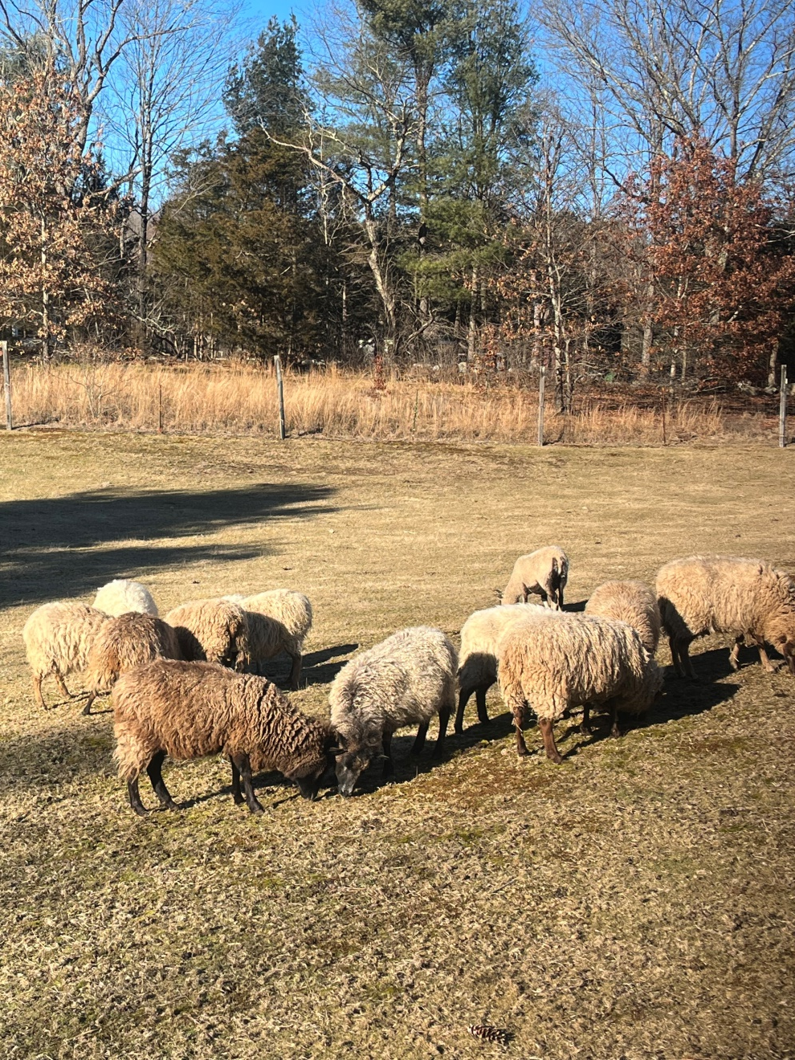
What is Wet Felting?
Wet felting uses sheep wool primarily (it’s more readily available and cheaper than alpaca, mohair or other). Adding soap, water and agitation to the wool results in a tightly woven fabric that can be flat or sculptural.
Shetland Sheep on my sisters farm in Massachusetts
Merino Sheep

Slide 2
Today’s Plan – Making a Fiber Sculpture
Get to know each other
  Breaks and stretching – super important
  Questions are welcomed throughout
What we are making today – you decide color and design
Wet felting – overview of the steps
Let’s get started!
  Laying out the wool, rubbing, rolling, sealing the cut edge and shaping
  Take a “before” photo
Examples of other items that can be made; your ideas?

Slide 3
Wet Felting - Reference
Try to use whatever you have around your home so that as you learn you don’t spend too much.
Bubble wrap or pool cover plastic
Felting net – any fabric that is porous so that the soap can get through to the wool. For example, sheer curtains or mesh laundry bag
Old hand or bath towels – they will get excess dye residue on them
Bar soap – olive oil, goat milk soap or any naturally made soap; some wet felters use Dawn dishwashing detergent
Water and a basin or pan to hold the water
A tool to spray the water on the wool. For example, a spray bottle (cheap option) or ball brause sprinkler (average $20-$25)
A template is not required but helps control the starting size of your piece – I use laminate underlay – I get mine from Amazon, cheaper than Home Depot
Sources I recommend for wool roving – all on Etsy:
  ChameleonFiberCo – very colorful roving
  EdgewoodGardenStudio – packets of colorful fibers
  HeartFeltSilks - ball brause sprinkler
  GaliBaba – white Merino and colorful Corriedale roving
Free U-Tube video on felting: Nicola Brown “How to Wet Felt – A Step by Step Tutorial” and she has lots of other free videos. I wet felt using her method.

Slide 4
When you Get Home - Fabric Care
When you get home or if you felt another item at home in the future: Rinse your piece in HOT water by hand, not in a washing machine. There will probably be some excess dye – that is normal. DO NOT wring or twist it. Once the water runs clear SQUEEZE it until no more water drips out. You can dry it FLAT outside in the sun.
Fabric care once it’s dry: If you drop food or liquid on it brush it off or run under water. DO NOT wash it in the washer as it will shrink down to nothing. Again, just SQUEEZE it dry and lay FLAT in sun if considerably wet.
Please don’t hesitate to contact me with questions or feedback via email at tallcactusstudio@gmail.com
Lucy

Slide 5
Your Notes

