Slide 1
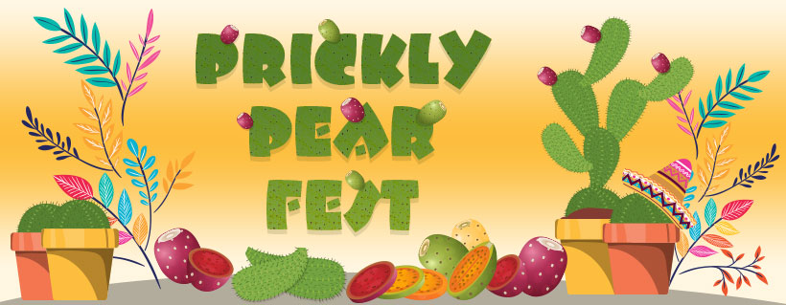
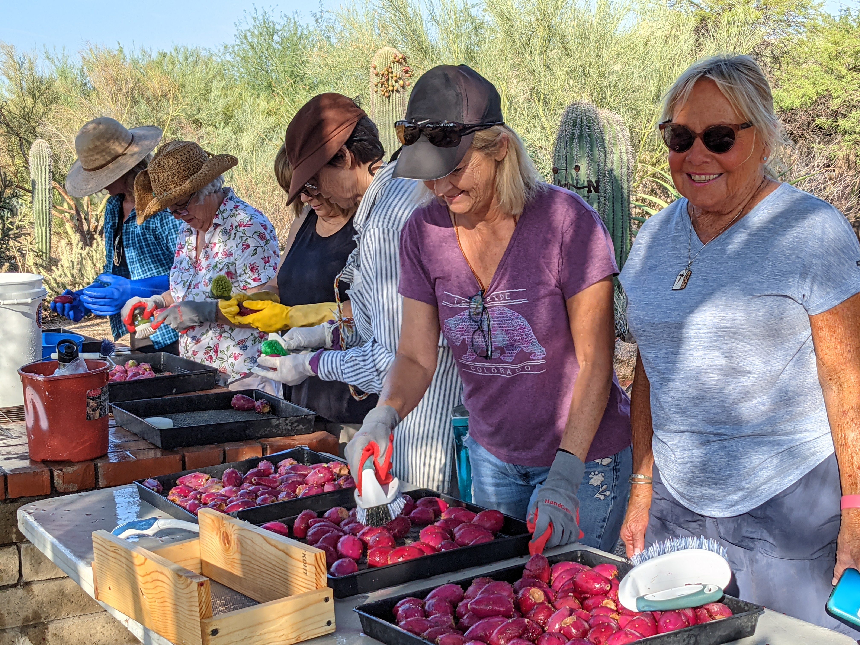
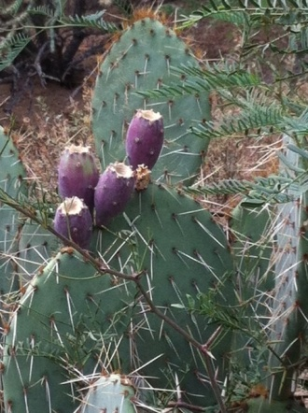
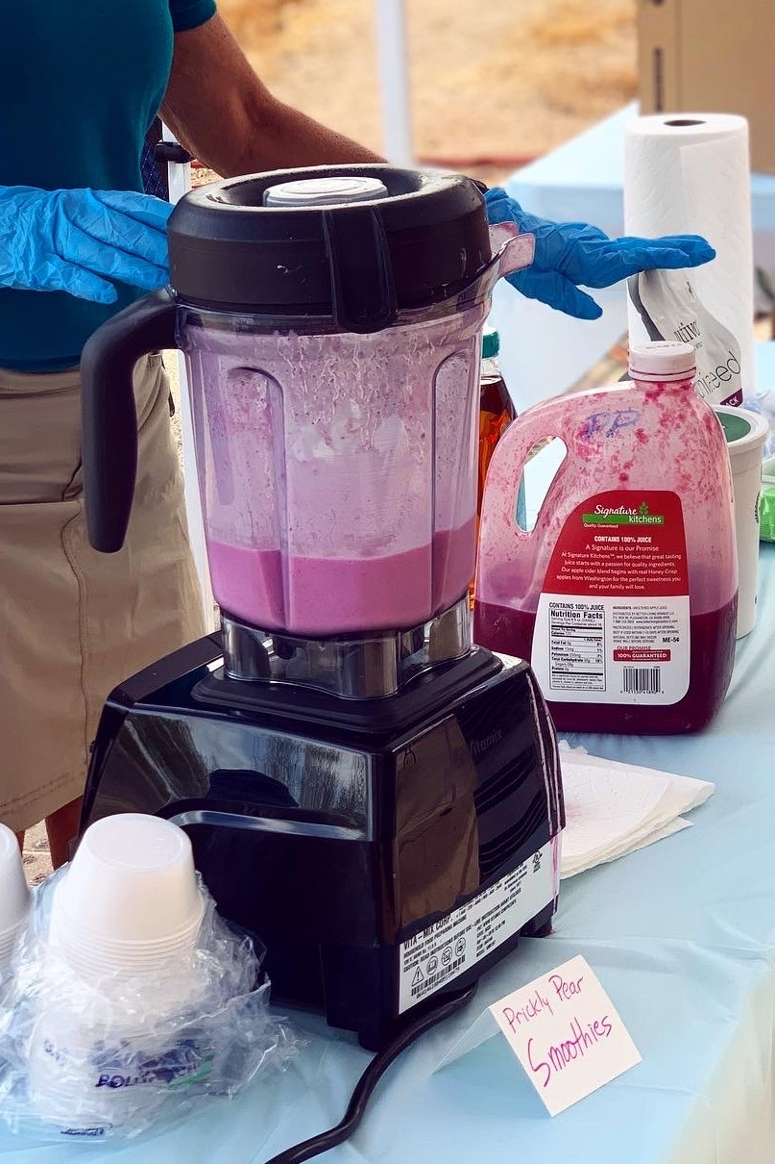
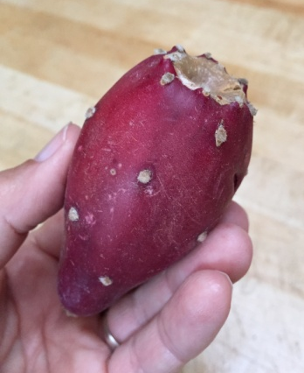
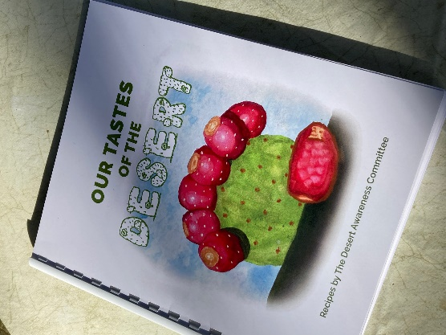
Saturday, October 29, 8-12
Presented by the Desert Awareness Committee
Activities will be outdoors at the
Holland Community Center
34250 N. 60th St, Scottsdale
Learn the amazing health benefits of the
Prickly Pear cactus!
Desert food tastings, demonstrations, new DAC recipe book…and more!
See how we harvest and clean
“Our Tastes of the Desert” Recipe book on sale now!
FREE to all desert lovers! Saturday, October 29, 2022 8am-noon

