Slide 1
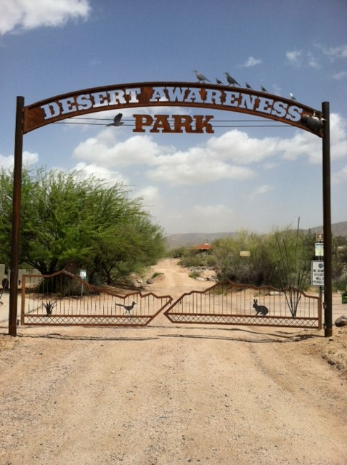
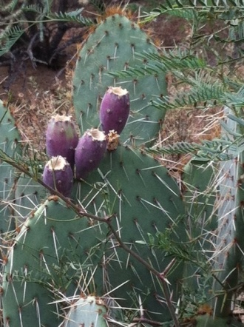
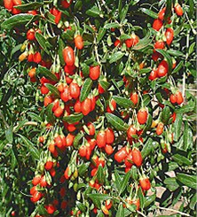
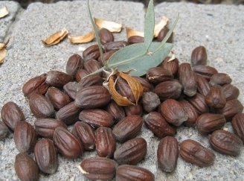
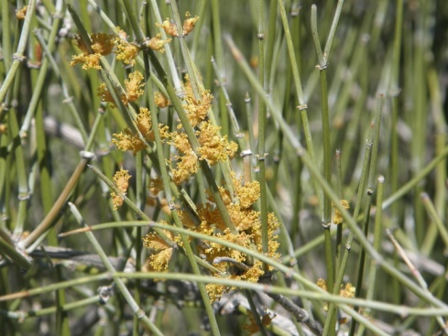
WALK, TALK, & TASTE IN THE PARK
FREE TO ALL
FREE TO ALL
SATURDAY,
APRIL 15, 2023
8-12
Small guided groups led continuously throughout the morning
38100 N Vermeersch
Turn at the corner of Cave Creek and Vermeersch Roads,
next to Cave Creek Building Supply
Presented by the
Desert Awareness Committee
You can live off the desert if you know what to pick and when. Find out as we stroll for an up-close look at the food producing plants.
Discuss harvesting techniques and food preparation ideas. Taste some recipes from our recipe book “Our Tastes of the Desert”.
Mormon Tea
Mesquite
Prickly Pear
Wolfberries
Jojoba

